Slide 1
Predicting the 2023 Minnesota Twins Attendance
Tom Bareket, Charles Hart,
Kennedy Johnson, Jack Rogers

Slide 2
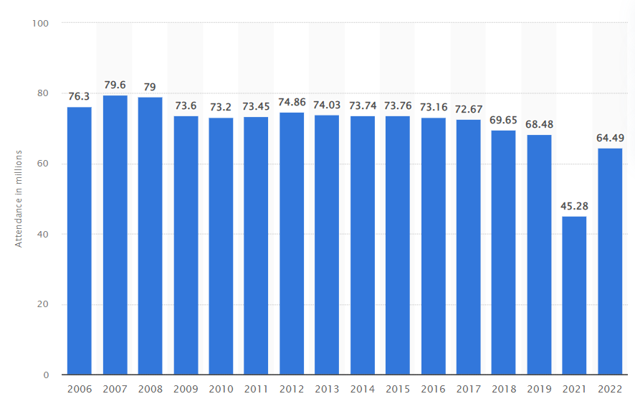
Introduction
Attendance (in millions) vs. year of MLB season
MLB attendance becoming a problem, even before COVID
How can we draw fans to the stadium?
81 home games = 81 chances to get fans in the ballpark
Source: Statistia

Slide 3
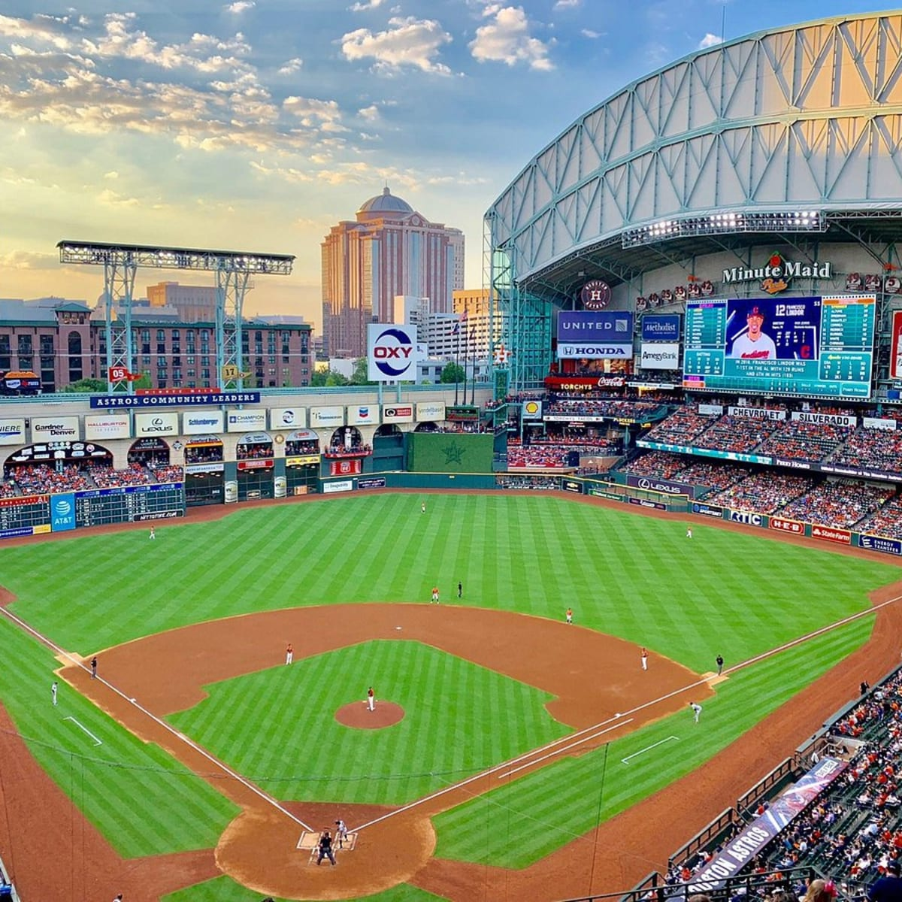
What is impacting attendance in the MLB?
First image on Google when searching “baseball game”
Have to think from the fan perspective
Typical thought of baseball: warm sunny day, hot dogs, home runs, beer, big crowd
Initial thoughts on what impacts attendance the most:
Weather
Strength of team
How close opposing team is
Divisional games
Day of week
Month
Game time
Best players
Source: TripAdvisor

Slide 4



Data Acquisition
Weather data
Average historical hourly temperatures during the game at each stadium (2pm for day games and 7pm for night games) between 1973-2022 from the nearest weather station(s) obtained using the meteosat library.
Meteosat uses the National Oceanic and Atmospheric Administration (NOAA) weather data for the US
Geospatial data
Distance between stadiums (home-team to away-team in lat/long units) obtained using geopy
Team strength data
ELO (overall strength) of MLB teams via FiveThirtyEight, game-by-game records since the 19th century
Player data
WAR data to estimate a teams “star power” was acquired from fangraphs using baseballr
Notes:
Baseball r open source baseball package for scraping for baseball data
Elo determined by overall strength of the team
Wins above replacement how many wins a player earns their team, how much additional value a player brings to their team over an average player

Slide 5
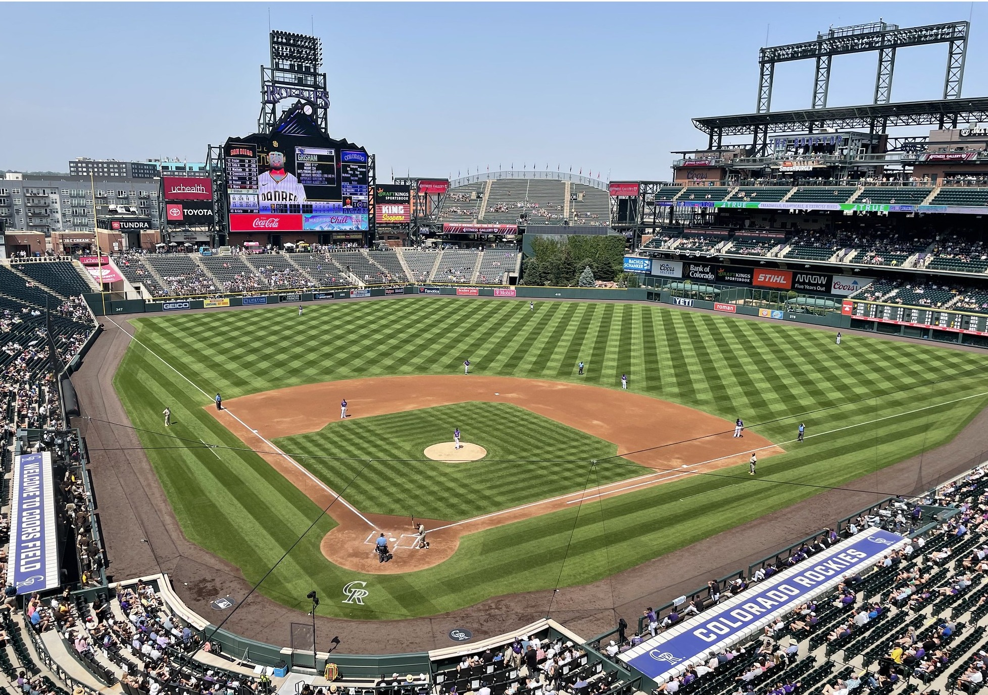
Data considerations and solutions
Searching for historical weather data using stadium lead to stadium names not being recognized (due to stadium name change, or unable to find using geopy)
This lead to the usage of approximate longitude/latitude coordinates of the stadium instead of stadium name to collect weather data.
Different team abbreviations or unlisted team abbreviations uses caused difficulties joining data. (“TBA”)
Altitude
Colorado’s Coors Stadium originally not searchable as a meteosat location point due to extreme differences in altitude, adjustments made allowed for weather stations to have data.

Slide 6
Modeling Process
Data Acquisition and Processing
Past academic researchers have used a variety of modeling approaches to forecast attendance at sporting events, from multiple linear regression, to neural networks. After some testing of different algorithms we decided on a gradient boosting algorithm due to its high accuracy, which held up when testing on a holdout set. For feature selection, we used a Boruta algorithm, and when optimizing our model to perform well on the holdout set, found that hyperparameters that focused on minimizing overfitting are optimal for future predictions
Exploratory Analysis
Model Selection
Feature Selection
Hyperparameter Optimization
Notes:
Boruta selection, feature importance, ordinal encoding

Slide 7
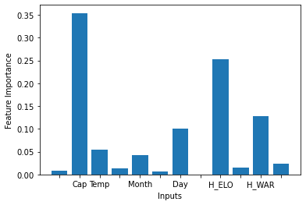
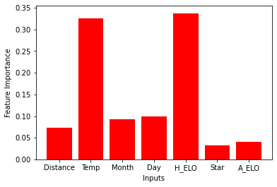
Modeling Takeaways
One of the most important takeaways from this process (aside from the actual predictions) is getting an idea of the most important indicators of attendance, and how this differs across teams. So we decided to both build a model using every team’s data, and compare the importance of different inputs with the model predicting Twins attendance.
Modeling at the beginning of the season inherently limits the data we can use. Attendance will vary a lot within a season, depending on a how well a team is performing. Using a staggered approach, that incorporates running win totals and recorded attendance would improve accuracy upon our before season approach.
Notes:
Include Feature Importance Graphs

Slide 8
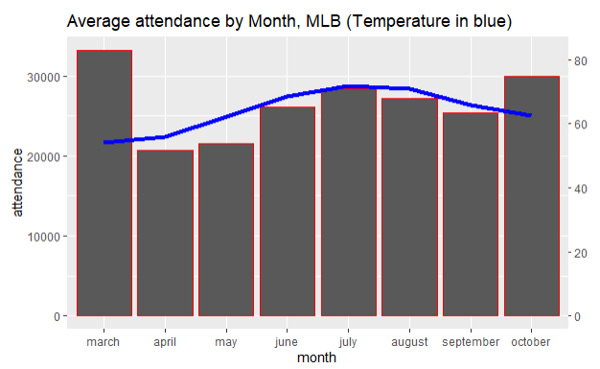
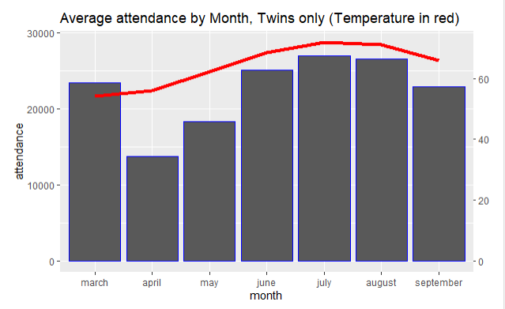
What separates the Twins? Weather.
Minneapolis is the coldest city home to a Major League Baseball team
Lower demand when temperature under 50 degrees Fahrenheit
Summer months (June, July) create their own demand
No “clear” indication of a great team in April

Slide 9
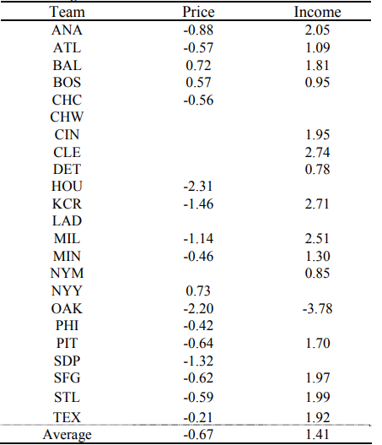
From a Business Perspective
Elasticity of Demand
Baseball teams generally have inelastic demand, Twins even more than most (-0.46)
When it comes to income, most teams have elastic demand - Twins are average at 1.3
Twins fans are more responsive to weather
Improve attendance
Raise ticket prices of games that fit:
Warmer temperatures
When Twins are higher in standings
Great opposing players (e.g. Angels)
Weekends
Reinvest the additional revenue into attracting fans
Promo nights
Marketing
Giveaways
Rewarding loyal fans/ season ticket holders
Reduce variable costs during cold months and weekdays
Concession workers
Security
Source: Park et al.

Slide 10
Works Cited
Park, K. W. (Ken), Lee, S., & Miller, P. (2013). Ticket Pricing Per Team: The Case of Major League Baseball (MLB). Journal of Economics & Economic Education Research, 14(3), 89–105.
Tripadvisor. Minute maid park (Houston) - all you need to know before you go. https://www.tripadvisor.com/Attraction_Review-g56003-d265524-Reviews-Minute_Maid_Park-Houston_Texas.html

